Slide 1
Project Mentor:
Dilavar Basha
Project Team Members- Group 4
H Sriharsha
Prakash Ravindra Thakur
Virender Singh

Slide 2
Project: Time Series Forecasting
Objective: To predict the stock price for the next 30 days. Predicting the stock price can be more beneficial for organizations. Company can gain more profit. Organizations can improve their business by applying trading strategies.

Slide 3
Project workflow
EDA (Exploratory Data Analytics)
Data Visualization( Gaining insights from data)
Feature Engineering (Handling variables and scaling)
Model Building
Model Evaluation
Model Deployment

Slide 4
EDA (Exploratory Data Analytics)
Stock price data contains 6,626 rows and 6 columns
Stock price data has a size of 39,756
No null, missing, duplicated values present in data set
Heat map plot concludes, there exists a co-relationship between the maximum features
Handling outliers

Slide 5
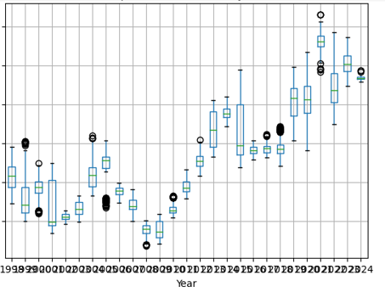
Data Visualization
From this box plot graph, we can conclude that closing price is varying with respect to time. we can confirm that, trend and seasonality exists for stock data set
Notes:
From this box plot graph, we can conclude that closing price is varying with respect to time. we can confirm that, trend and seasonality exists for stock data set

Slide 6
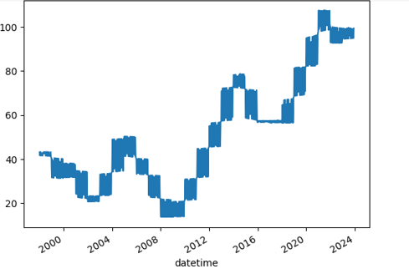
Trend Plot
From this trend plot we can conclude that trend is increasing

Slide 7
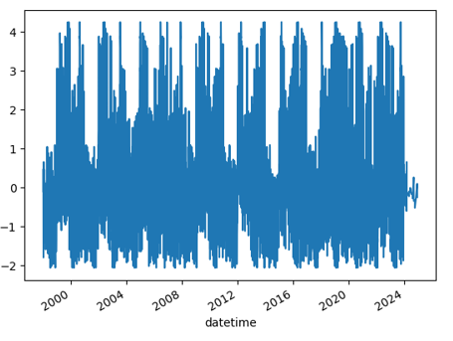
Seasonality plot
From this seasonality plot we can conclude that seasonality exists

Slide 8
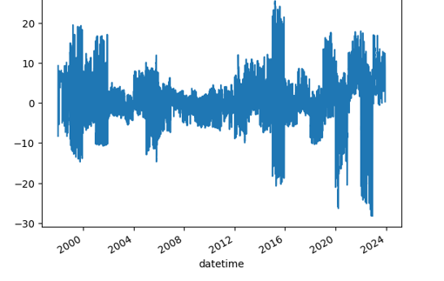
Noise plot
From this noise plot we can conclude that noise exists

Slide 9
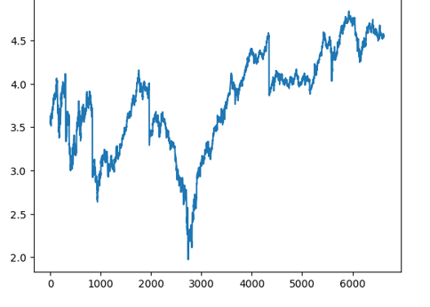
Removing Noise
Applying log functions to eliminate the noise and the graph looks like this

Slide 10
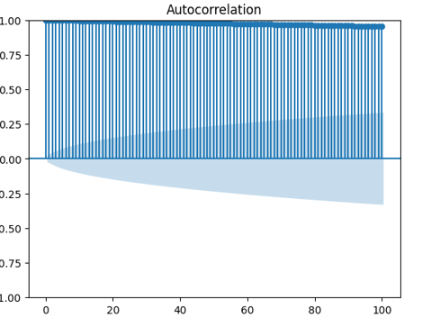
ACF Plot
From Acf plot, we can conclude that the today's data is dependent on tomorrow's data, there exists a correlation up to some lag limit, once it crosses certain lag limit, correlation decreases gradually

Slide 11
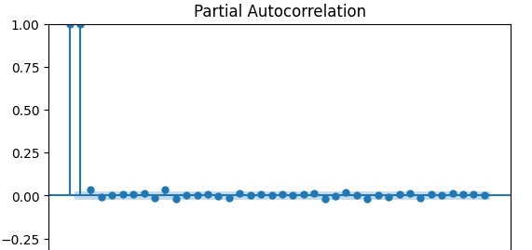
PCF Plot
From pcf plot, we can conclude that
Correlation between the prices are consistent, not varying too much with respect to lag points

Slide 12
Feature Engineering
In our data set, we don't have any categorical data, so we are not dealing with conversion of data from categorical to numerical.
Applying standardization by using Standard scaling method
Calculated average closing price and average volume in order to check variation

Slide 13
Model Building
We have implemented different types of models for predicting
Closing price for the next 30 days.
Differencing method to convert non-stationality data to stationality.
Conducted Ducky-fuller test in order to confirm, data is stationality by comparing p value with alpha value

Slide 14
For model building, we opted ARIMA model and LSTM
Model for predicting the price.
Among ARIMA and LSTM, ARIMA model gave least mean squared value
Finally, we choose ARIMA model for model deployment

Slide 15
Model Deployment
Deployed the model through streamlit app
Actual and predicted prices are streaming in our web app

Slide 16
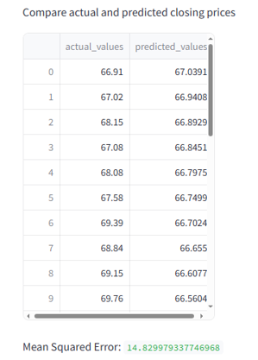
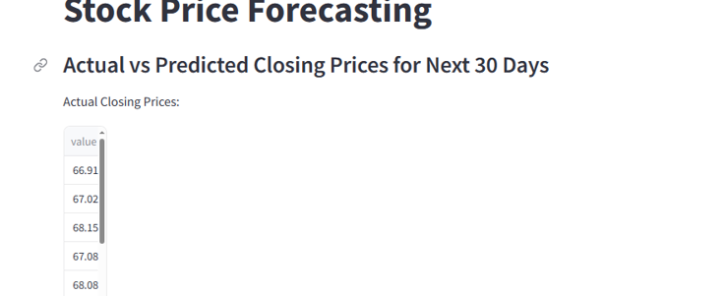
Stream lit web app

Slide 17
Challenges Faced
When we started to work on model building part, it was very challenging for us to choose a better performing model.
While evaluating performance of the model, we faced some challenges
Minor errors were encountered when we started to build Lstm model for predicting price

Slide 18
Conclusion
In conclusion, the project aimed to predict stock prices using various machine learning techniques and historical data. Through the implementation of different algorithms such as ARIMA , differencing methods or LSTM neural networks, we have successfully builded the model and forecasted future stock prices based on past trends and market indicators.

Slide 19
Thank you

